Slide 1
Traffic Flow Prediction System
Hoàng Minh Đức
Nguyễn Hoàng Tuấn Kiệt

Slide 2
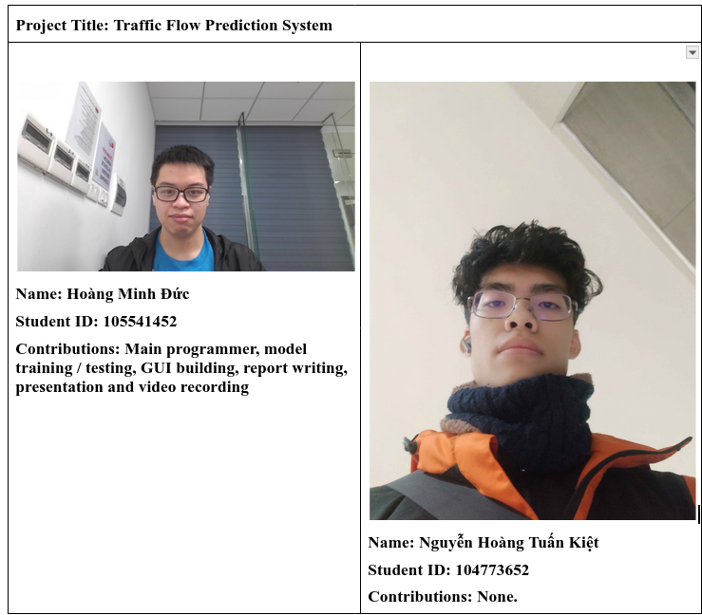
Team Page

Slide 3
Why Traffic Flow?
Traffic flow Prediction is crucial for:
Traffic planning in navigation apps such as Google, which helps urban planning
Route planning, for navigation
Public transport planning
Logistics and Delivery

Slide 4
Data and methodology
In this process, we are using the Boroondara 2006 data to train a model that will predict the traffic flow in various sites.
To achieve this, first we process the data to result in a matrix. This matrix contains the Flow Information: every row is a location, every column is a timestamp.

Slide 5
Data
The data in this process include:
Sensor SCATS region number, Road names, Latitude and Longitude
Actual flow data in 15-minute intervals from Oct 1 2006 to Oct 31 2006
Some various categorical data.

Slide 6
Data processing and Model approach
To process the data, first We seperated all of the sensors using an Identifier; a combination of the HF Vicroads Internal value and the SCATS region value.
We transform the dataset to include other data via-identifier (lat, long, flow, etc)
We flatten the flow so it becomes a single row with 15-minute sequential data.
In order to help create windows for later, we transpose the dataset.
We will use a time-series LSTM Model approach to solve this problem.

Slide 7
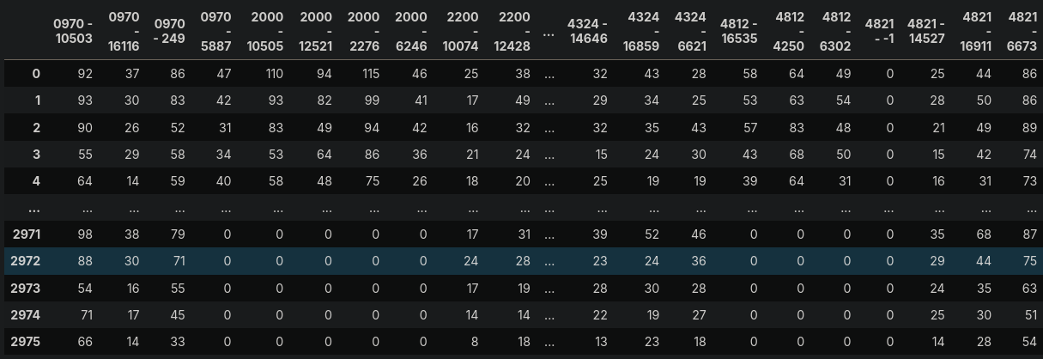
Data after processing

Slide 8
Windows
After having the data, we create time-series windows. Each window is 1 week long (672 15-minute intervals) of data.
We set the horizon=24 to predict 24 15-minute intervals (5 hours) ahead.
We create two window arrays: X for all values but last HORIZON steps, y for all next HORIZON steps. X is split into X_train, X_val, X_test respectively, as well as y_train, y_val, y_test for y

Slide 9
Model approaches
We train multiple-location LSTM and GRU models to predict the data over all of the locations.
This approach allows locations that are close geographically to be able to learn pattern from others.

Slide 10
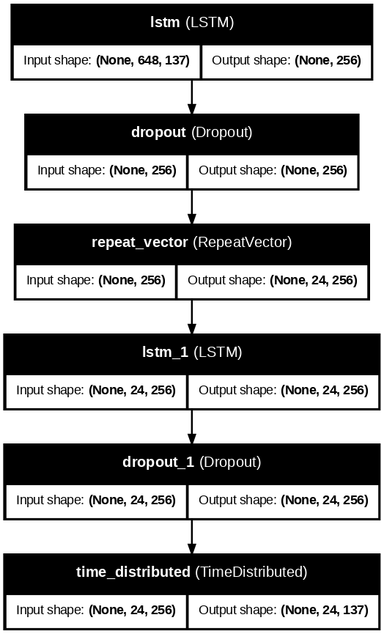
Model Architecture - LSTM
The LSTM model has the following layers that follow an encoder-decoder architecture:
Input: receive input (not shown in plot)
First LSTM layer: Process the sequence and compresses it to a 256-dimensional context vector
First Dropout: Regularization, zeros out 20% of input to not overfit
RepeatVector: Repeat the context vector 24 times for the decoder to use as initial input
Second LSTM: Takes the repeated context vector and processes the information required to predict the time step
Second dropout: similar regularization
TimeDistributed: Convert hidden states to final predictions

Slide 11
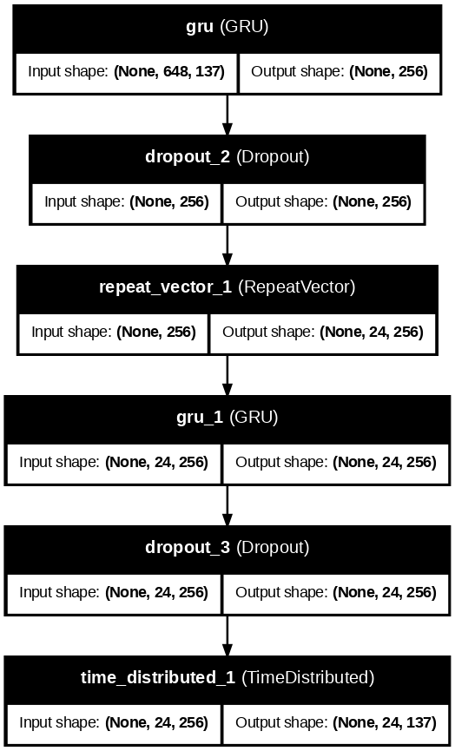
Model Architecture - GRU
The GRU model has a similar architecture to the LSTM model, with the LSTM layers replaced by the GRU layers due to their similar functionality.

Slide 12
Training
We split the data into groups of train/val/test with ratios 70-15-15
Before training, we normalize the data for the neural network using a Standard Scaler. (zero mean, unit variance).
Both models use AdamW as their optimizer, as well as having EarlyStopping (stop training when loss doesn’t change much) and ReduceLROnPlateau (reduce learning rate to keep training) callbacks.
Models are trained on normalized data. Therefore, predictions are normalized, and a denormalization is required to obtain real values.

Slide 13
Prediction results
Metric | Normalized |  | Denormalized
 | LSTM | GRU | LSTM | GRU
MAE | 0.394569 | 0.356201 | 34.609779 | 31.244328
MSE | 0.504611 | 0.406004 | 3882.469204 | 3123.785721
RMSE | 0.710360 | 0.637184 | 62.309463 | 55.890838
R2 | 0.448813 | 0.556522 | 0.448813 | 0.556522

Slide 14
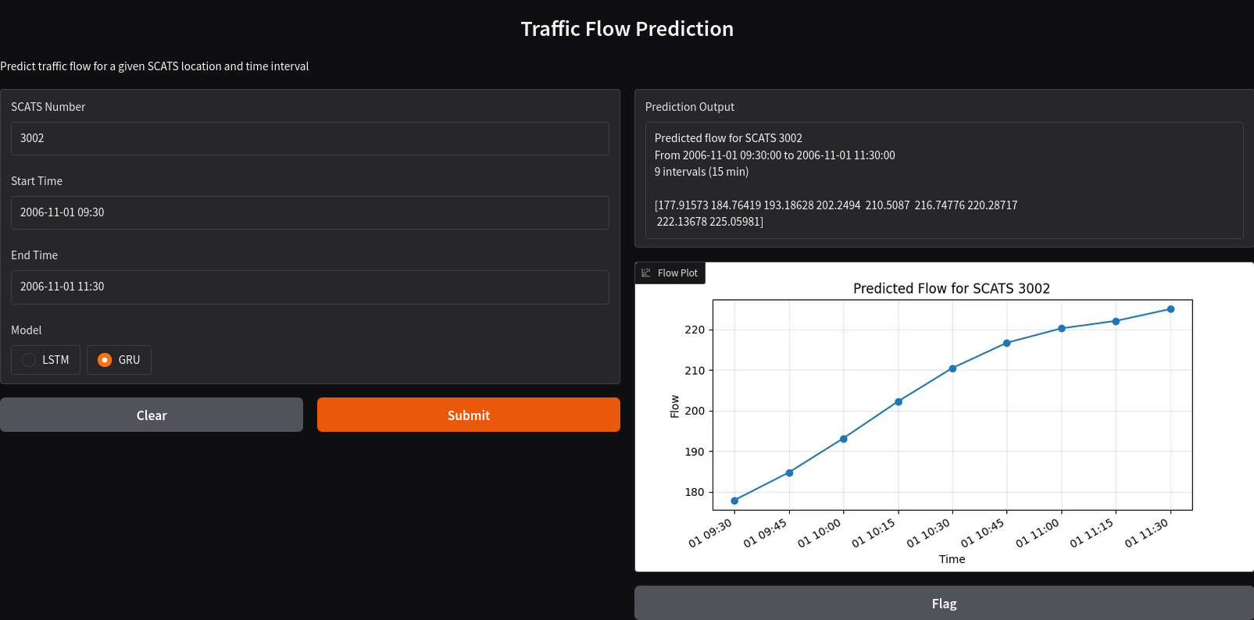
UI

Slide 15
Limitations and Future work
Low accuracy. The MAE and RMSE is currently high, which we will mitigate using hyperparameter tuning, as well as discover other models.
Needed routing future for GUI
Adapt to different datasets.

Slide 16
Thanks for Listening!

